Slide 1

1 KINGS

Slide 2
1 KINGS
⁴ "‘You have seen what I did to the Egyptians, and how I bore you on eagles’ wings and brought you to Myself. ⁵ Now therefore, if you will indeed obey My voice and keep My covenant, then you shall be a special treasure to Me above all people; for all the earth is Mine. ⁶ And you shall be to Me a kingdom of priests and a holy nation.’ These are the words which you shall speak to the children of Israel.”
Exodus 19.4-6

Slide 3
1 KINGS
1 & 2 Kings divided by LXX
3 Sections:
United monarchy (970 BC) ~ 1 Kings 1-11
2 Nations (930 BC) ~ 1 Kings 12- 2 Kings 17
Judah (722 BC) ~ 2 Kings 18-25

Slide 4
1 KINGS
Author: Ezra, Ezekiel, Jeremiah or unnamed prophet
The Book of the Acts of Solomon (11:41)
The Chronicles of the kings of Israel (14:19)
The Chronicles of the kings of Judah (14:29)

Slide 5
1 KINGS
Introduction formula in Kings
Name and relationship to predecessor
Date of accession
Length of reign
Place of reign
Mother’s name (Judah only)
Spiritual report card

Slide 6
1 KINGS
³¹ So Rehoboam rested with his fathers … Then Abijam his son reigned in his place.
¹ In the eighteenth year of King Jeroboam the son of Nebat, Abijam became king over Judah. ² He reigned three years in Jerusalem. His mother’s name was Maachah the granddaughter of Abishalom. ³ And he walked in all the sins of his father, which he had done before him; his heart was not loyal to the Lord his God, as was the heart of his father David.
1 Kings 14.31-15.3

Slide 7
1 KINGS
before the priests, the Levites. ¹⁹ And it shall be with him, and he shall read it all the days of his life, that he may learn to fear the Lord his God and be careful to observe all the words of this law and these statutes, ²⁰ that his heart may not be lifted above his brethren, that he may not turn aside from the commandment to the right hand or to the left, and that he may prolong his days in his kingdom, he and his children in the midst of Israel.
¹⁶ But he shall not multiply horses for himself, nor cause the people to return to Egypt to multiply horses, for the Lord has said to you, ‘You shall not return that way again.’ ¹⁷ Neither shall he multiply wives for himself, lest his heart turn away; nor shall he greatly multiply silver and gold for himself.
¹⁸ “Also it shall be, when he sits on the throne of his kingdom, that he shall write for himself a copy of this law in a book, from the one
Deuteronomy 17:16-20

Slide 8
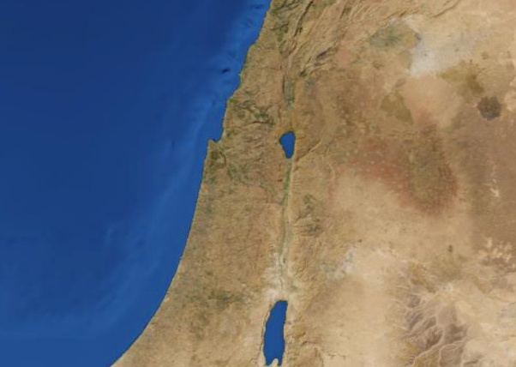
1 KINGS
Dan
Israel
Bethel
Jerusalem
Judah
Pagan Altars of Israel

Slide 9
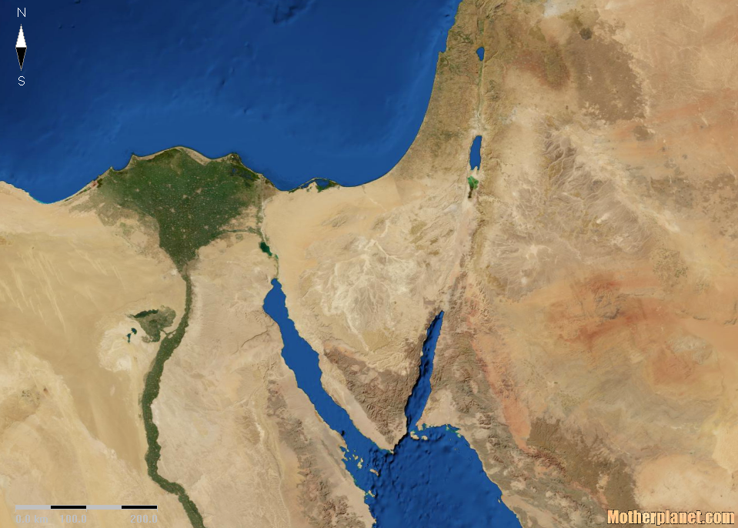
1 KINGS
Mt. Carmel
Beersheba
Mt. Sinai
Elijah’s flight after Mt. Carmel

